Slide 1
G.T.M.O
Jose Ortiz
Penn State Hazelton
CAS 100 Speech Communication
October 18, 2009

Slide 2
http://www.youtube.com/watch?v=xKCxTbVxQ-o

Slide 3
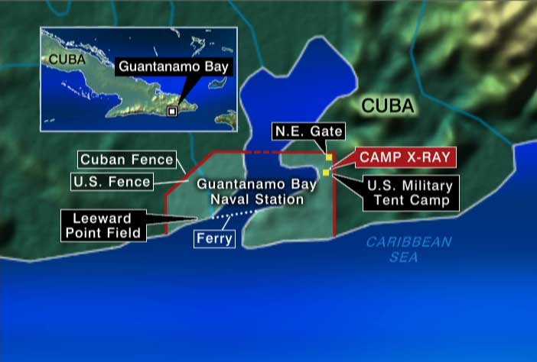
Start Of Guantanamo Bay
1903 President Roosevelt signs agreement
1934 new lease was negotiated that included Fulgencio Batista
1971 Fidel Castro expresses how he feels with the U.S owning GTMO

Slide 4
Becoming a Prison

