Slide 1
Gun Control
Jose Ortiz
Penn State Hazelton
CAS 100 Speech and Communication
11/11/09

Slide 2
Overview
Constitution
Brady bill & Assault Weapons Ban
Murder by numbers
Firearms=suicides
Decrease of deaths
Accidents from happening
conclusion

Slide 3
2nd amendment
“A well regulated militia, being necessary to the security of a free state, the right of the people to keep and bear arms, shall not be infringed”
This is basically saying that it is ok for people to own guns no matter who you are
Also stating that people are allowed to buy guns for self-defense

Slide 4
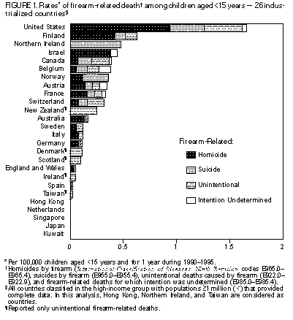
Murder by Numbers
In 1997, out of the 15,289 murders in the United States, 10,369 were committed by firearms
In that same year out of the 7,927,000 violent crimes that took place, 691,000 were committed by firearms
In 2006, there were 30,896 gun deaths in the U.S: 12,791 homicides (41% of total deaths), 16,883 suicides (55% of total deaths), 642 unintentional shootings (2% of total deaths), 360 from legal intervention (1.2% of total deaths) and 220 from undetermined intent (.8% of total deaths).

Slide 5
Suicide
One of the major uses of firearms is suicide
When owning a gun, people tend to use it when they are depressed, emotionally unstable, or experiencing psychological or physical stress
Mostly males choose firearms as an act of suicide
Also some kids/teenagers uses guns for suicide when in the house

Slide 6
The start
The Brady Bill
Assault Weapons Ban
The Brady Bill is a law that requires a five working day period for handgun purchases
From 1994 through 2008, 1.8 million attempted firearm purchases were blocked by the Brady background check system.
For checks done by the FBI in 2008, felons accounted for 56 percent of denials and fugitives from justice accounted for 13 percent of denials.
In April 2009, the FBI announced it had completed its 100 millionth NICS approval since its inception 10 years before
This bill was created in 1994
This bill banned the manufacture, possession, and importation of semiautomatic assault weapons for civil use
Some weapons that were included in this bill were bayonet mount, grenade launchers, and pistol grips.
Since bill was enact 19 of the deadliest assault weapons are harder to find on the streets
Less then 1% of homicides involved an assault weapon since bill was enact

Slide 7
Lower Rates
Decreasing Deaths
Avoiding Accidents
Not owning guns will decrease the number of deaths in the world
The Brady bill and Assault weapon ban have been helping reducing the amount of deaths per year.
People who have guns that are not experienced are most likely to have an accident with a gun
Children that are in a household with a gun are also likely to have an accident

Slide 8
The Future
The fact that we have so many gangs and hate groups that rely on guns for protection are affecting the kids for the future.
Major argument that more guns equals less violence

Slide 9
Recap
Even though the second amendment states that people have guns for self-defense, it rarely happens. More people uses guns for violence, murders, and suicides rather then self-defense and that is what is wrong with the world today. With the Brady Bill and Assault Weapons Ban, is helping the world be safer ever since 1994 but the U.S sees that its not as safe as they want it and some feel that we need a better law.

Slide 10
Biblography
http://www.awesomelibrary.org/guncontrol.html
http://www.justfacts.com/guncontrol.asp
http://www.guninformation.org/
http://www.howtodothings.com/sports-recreation/understand-the-pros-and-cons-of-gun-control
http://www.buzzle.com/articals/pros-and-cons-of-gun-control.html
http://www.cdc.gov/mmwr/preview/mmwrhtml/00046149.htm
http://en.wikipedia.org/wiki/Brady_Handgun_Violence_Prevention_Act
http://www.kc3.com/editorial/40reasons.htm
http://www.benbest.com/lifeext/murder.html
http://www.ichv.org/Statistics.htm

